Slide 1

data analyst professional CERTIFICATE practical exam
product sales analysis for:
PENS AND PRINTERS
by: oluwagbemiro odegbami

Slide 2
Product Sales Methods Brief
Six weeks ago we launched a newline of office stationery.
Despite the world becoming increasingly digital, there is still demand for notebooks, pens and sticky notes. Our focus has been on selling products to enable our customers to be more creative, focused on tools for brainstorming.
We have tested three different sales strategies for this, targeted email and phone calls, as well as combining the two.
Email: Customers in this group received an email when the product line was launched, and a further email three weeks later. This required very little work for the team.
Call: Customers in this group were called by a member of the sales team. On average members of the team were on the phone for around thirty minutes per customer.
Email and call: Customers in this group were first sent the product information email, then called a week later by the sales team to talk about their needs and how this new product may support their work. The email required little work from the team, the call was around ten minutes per customer

Slide 3
focus questions for exploratory analysis :
Q1 - how many customers were there for each approach?
Q2 – what does the spread of the revenue look like overall? And for each method?
Q3 – was there any difference in revenue over time for each of the methods?
Q4 – based on the data, which method would you recommend we continue to use?
note - some of these methods take more time from the team so they may not be the best for us to use if the results are similar.

Slide 4
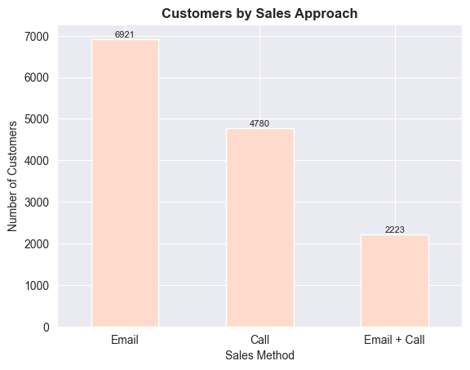
Exploratory Analysis – 1 How many customers were there for each approach?
The number of customers for each approach can be seen through the bar-plot.
We have 6921 sales made by email approach.
4780 sales were made by call.
Another 2223 were made by the email and call combination approach. The graph shows the specific numbers of each sale.

Slide 5
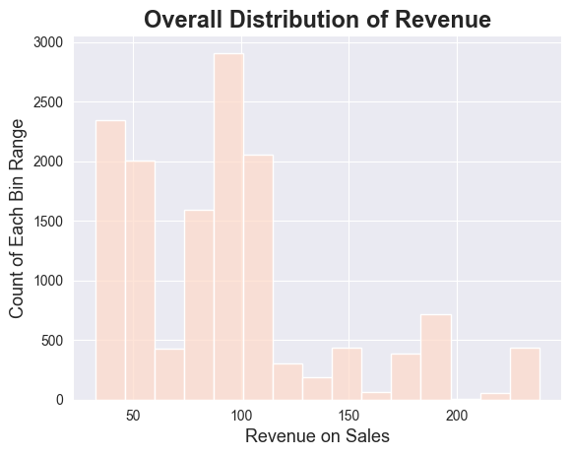
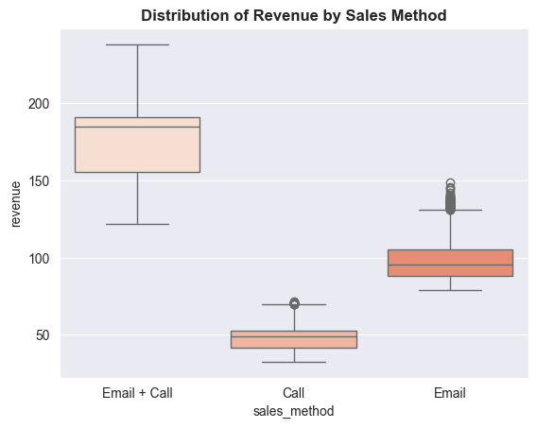
Exploratory Analysis – 2.1 What does the spread of the revenue look like overall?
Our histogram plot shows there's a major revenue accumulation in the $40 - $90 range. Our mode(most-occurring payment) was in the $80 - $100 range.
We can deduce that the "Email + Call" sale method has the highest set of revenue income. The "Call" method has the lowest.

Slide 6
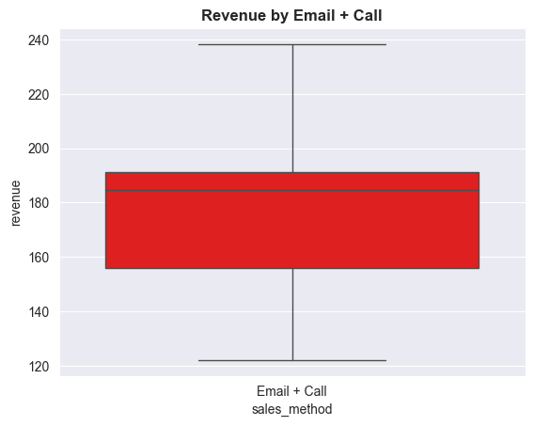
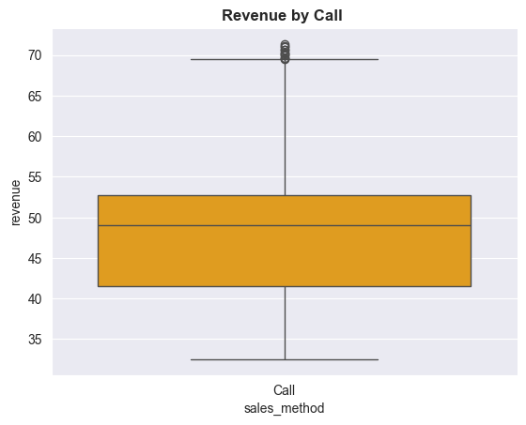
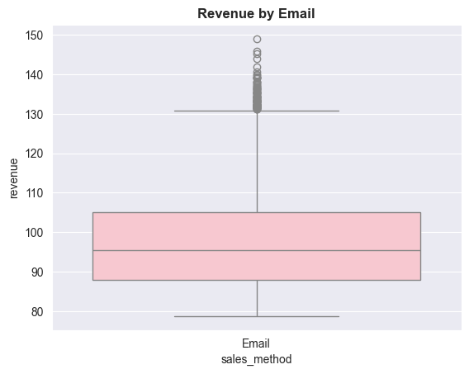
Exploratory Analysis – 2.2 What does the spread of the revenue look like overall?
Boxplot here shows the different ranges of the different sales methods.
“Email + Call” method has a range from a little above 120 to 240 showing how spread the revenue was for that method.
We can also see a few outlier records in the singular "Email" and "Call" approach.

Slide 7
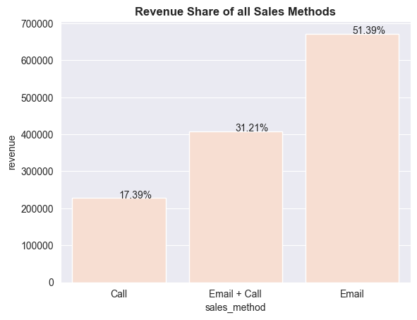
Exploratory Analysis – 2.3 What does the spread of the revenue for each sales method look like?
The "Email" approach brought in 51.39% of the total revenue over the six-week period, with "Email + Call" method bringing in 31.21%.
The "Call" method had the lowest return bringing just 17.39% of total revenue.

Slide 8
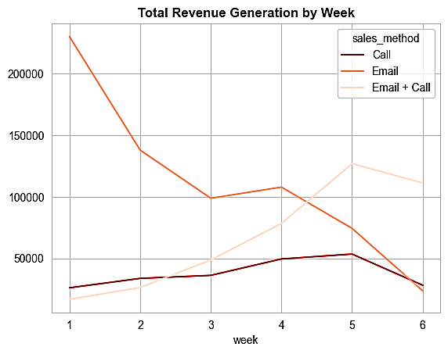
Exploratory Analysis – 3.1 Was there any difference in revenue over time for each of the methods?
This chart shows the "Email" method as an early revenue generator in the early weeks of sales with the "Call" and "Email + Call" method picking up gradually as the weeks go by.
The "Email" method declined at a steady rate as the weeks went by. The reason that this happened can be found through a survey with the customers and that data has not been made available to us.
At the end of the 6th week, the "Email + Call" method was the current-highest total revenue generating sales method.

Slide 9
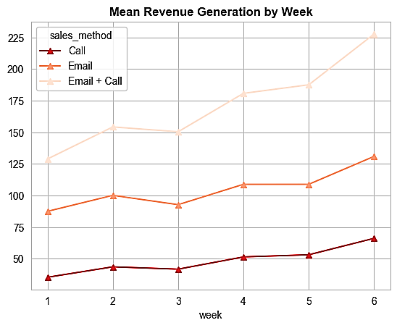
Exploratory Analysis – 3.2 Was there any difference in revenue over time for each of the methods?
This chart shows the "Email + Call" method as a high average revenue generator per week.
The "Call" method improved at a steady rate as the weeks went by but could never generate an average of $75 per customer at any point.
The "Email + Call" method brought in our highest average of >$225 in the 6th week.
The "Email" method had a mean revenue of >$125 but <$137. This line plot shows these with the use of markers at the average point.

Slide 10
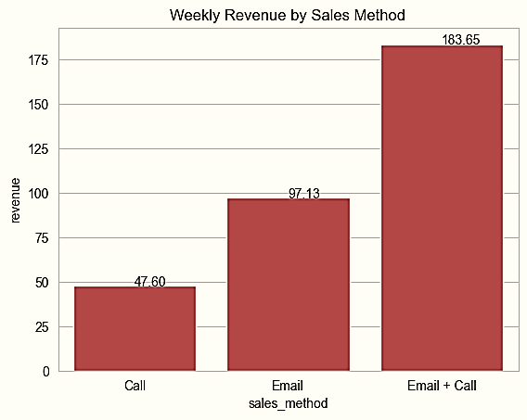
method to keep? method to dump?
According to the bar chart above, the "Email + Call" approach gives the best mean weekly revenue. The priority for customer approach should be the "Email + Call" approach with the "Email" approach taking next priority. The stand-alone "Call" procedure should be phased out gradually.

Slide 11
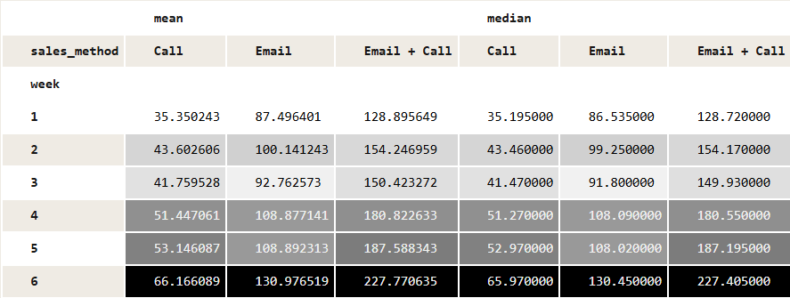
Business Metric Monitor – what do we monitor to keep a good pace and make sure we’re on the right track ?
The company should focus on these metrics if they are dedicated to increasing revenue and the values in this pivot table should be marked as their initial values. These metrics are measured over time and it can be reviewed weekly so as to make sure they are on the right path with their sales methods and customer approach.
The metric to be used for the business monitor is the weekly mean metric. This metric will provide the average revenue of the sales, serving as a good measure of central tendency.
By utilizing the mean, we ensure that all data points contribute to the final result, giving us a comprehensive understanding of the overall trends and patterns around the sales.
The weekly initial estimates for the metric for the Call, Email and Email + Call approach are $66.17, $130.98 and $227.77 respectively.

Slide 12
Final Summary + Recommendations
My recommendation would be to move away from the lone Call approach as it seems to be producing the worst results of all the sales methods. It is also very time-consuming when compared to using the "Email + Call" approach. The Call approach takes approximately 30 minutes per customer while the Call part of the "Email + Call" approach takes approximately 10 minutes per customer.
The Email approach could also be re-defined with an improved analysis into why people responded to that approach. That way, we can be able to know what demography of people responded to the Email approach and make it more targeted.
There should also be follow-up emails to the Email approach and Email + Call approach. This way, people who have opened the first email are able to see the second email and finally act on what they plan to do.
The data collection methods can also be improved because there were 1074 missing values in our dataset which could be major to our final analysis.
I believe with these analysis and recommendations implemented, we can be sure we are using the best techniques to sell the new product effectively.

